Slide 1
Machine Learning
Unit – 2 – [Part 1]
Bayesian Decision Theory

Slide 2
Bayesian Decision Theory
Bayesian Decision Theory is a decision-making framework that uses probabilities to make the best possible choice when dealing with uncertainty. It combines likelihoods, prior knowledge, and the costs or benefits of decisions to choose the option that minimizes risks or maximizes rewards.
The Naïve Bayes classifier is a specific application of Bayesian Decision Theory. It uses the principles of Bayes' Theorem to classify data into categories, making it a probabilistic model for decision-making.
Bayesian Decision Theory is a method for making decisions when you're uncertain about the outcome. It combines the following elements:
Probabilities: These show how likely something is to happen. For example, the chance of an email being spam or not spam.
Prior Probabilities: This represents what we already know. For instance, if we know that 60% of emails are typically spam, we use that as our prior knowledge.
Posterior Probabilities: After we gather new evidence (like certain words in the email), we update our knowledge. By combining prior probabilities with this new evidence, we calculate the posterior probability, which gives a more accurate prediction of whether the email is spam or not.
Costs or Benefits: Every decision comes with consequences. If you classify a spam email as non-spam, there's a cost (wrong decision). If you classify it correctly, there is no cost (correct decision).
In essence, Bayesian Decision Theory helps us make the best choice by using these elements, aiming to minimize potential losses and maximize the possible gains.

Slide 3
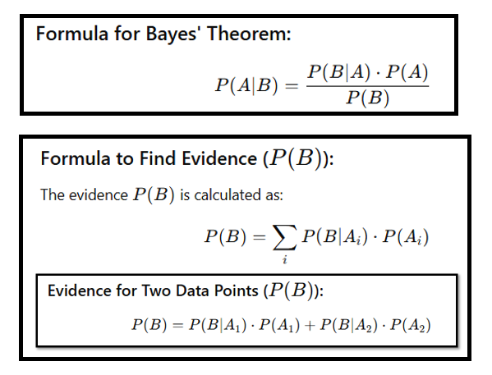

Slide 4
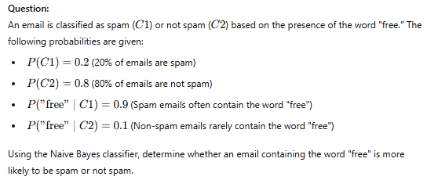
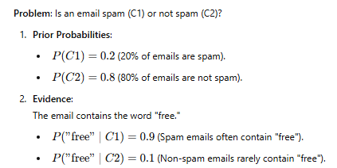

Slide 5
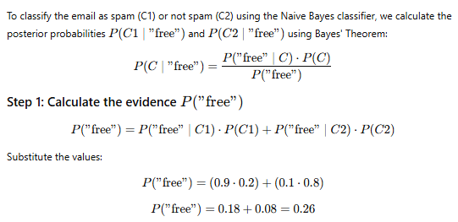
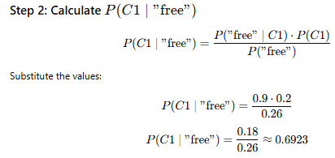

Slide 6
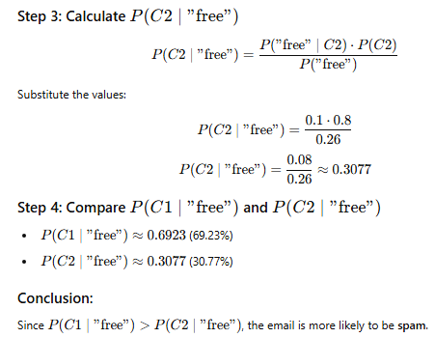

Slide 7
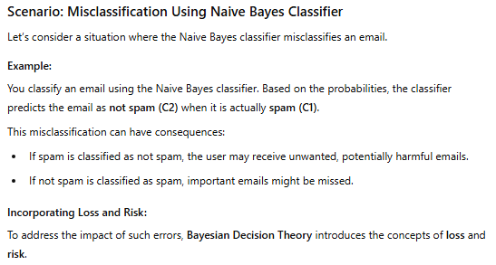
Losses and Risks

Slide 8
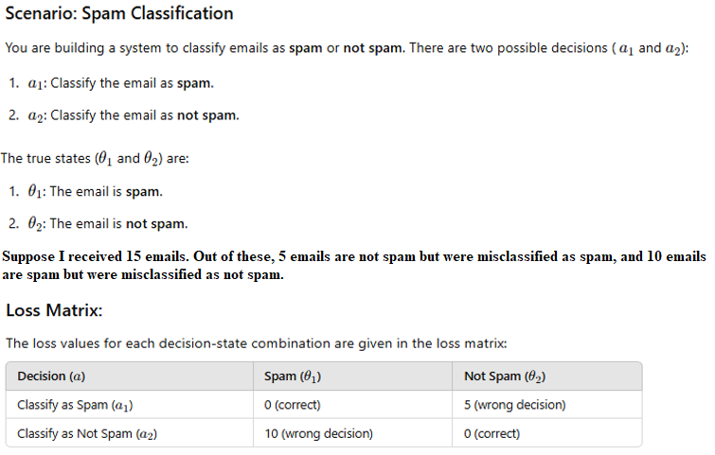

Slide 9
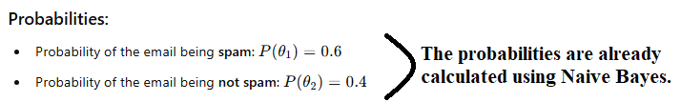
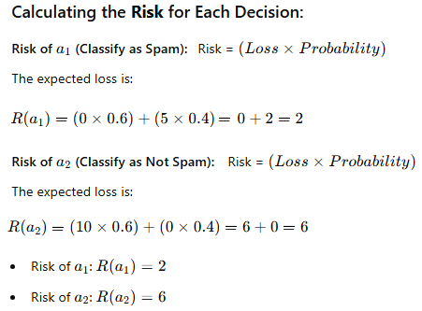




Slide 10
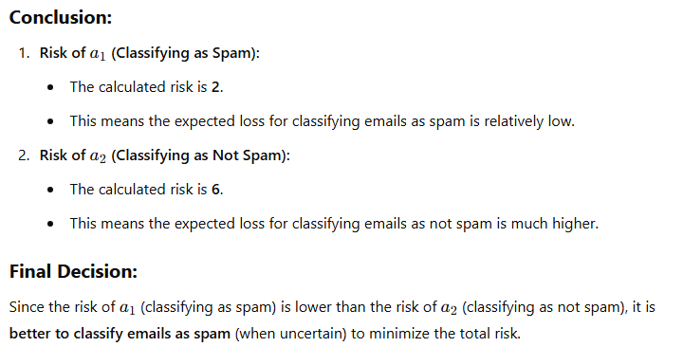

Slide 11

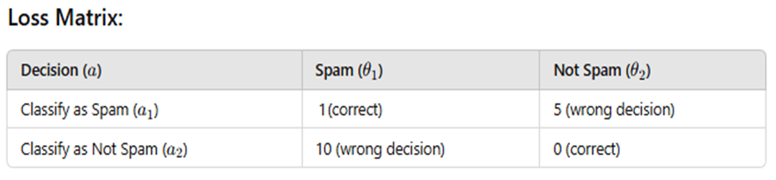
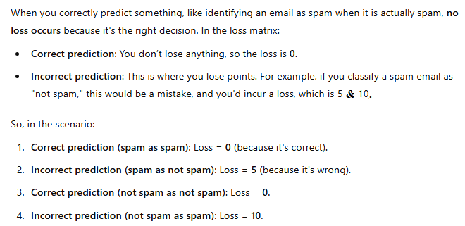

Slide 12

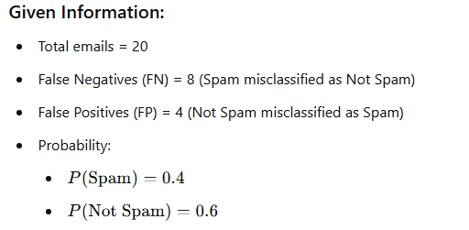
Another Example:-

Slide 13
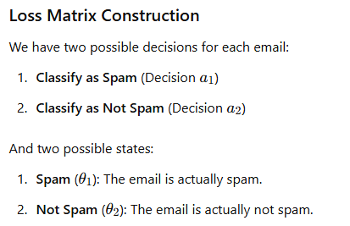
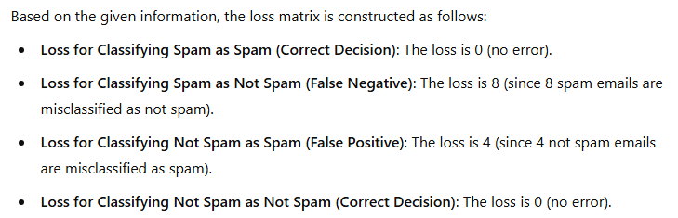

Slide 14
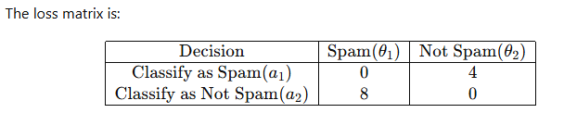
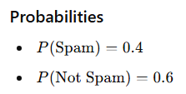
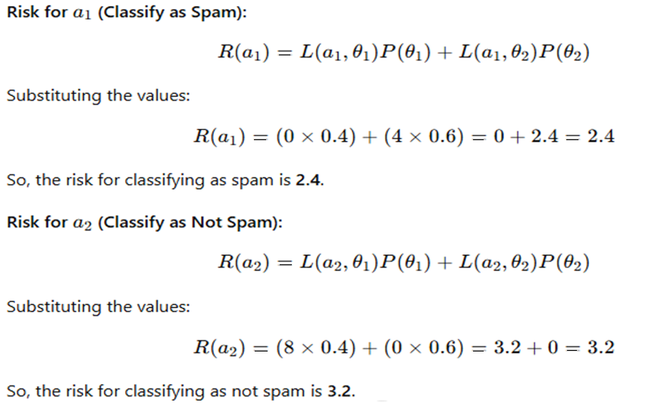

Slide 15
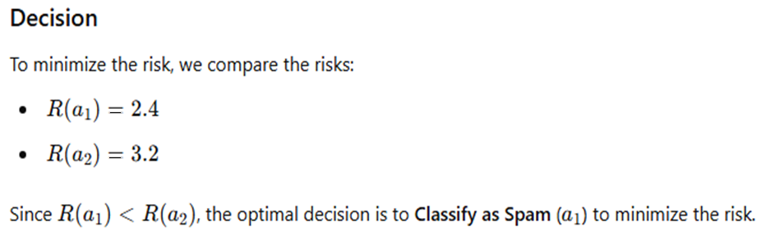
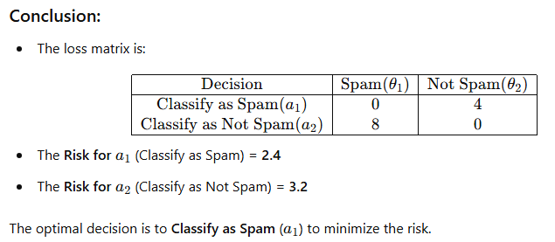

Slide 16
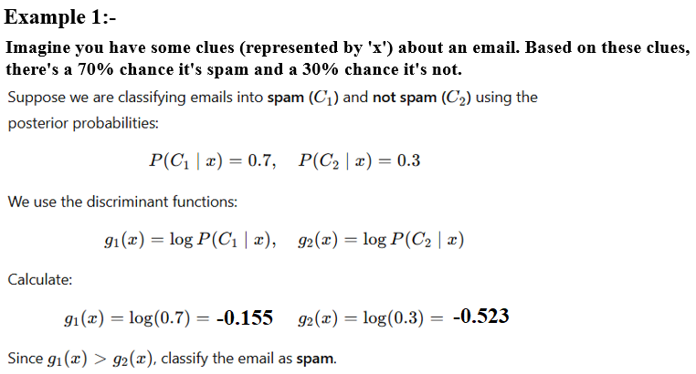
Discriminant Functions

Slide 17


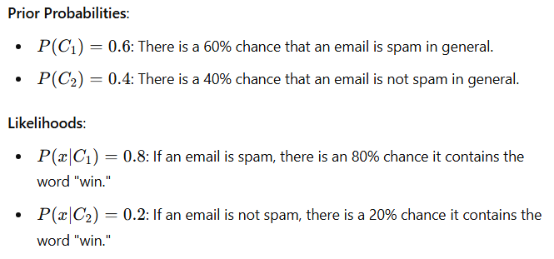

Slide 18
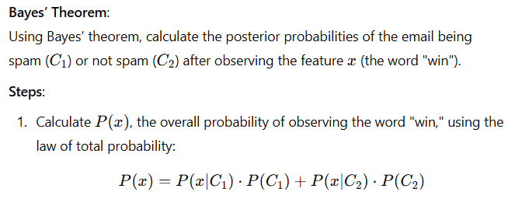
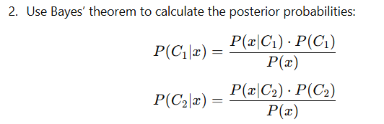

Slide 19
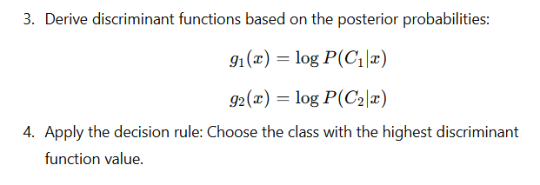
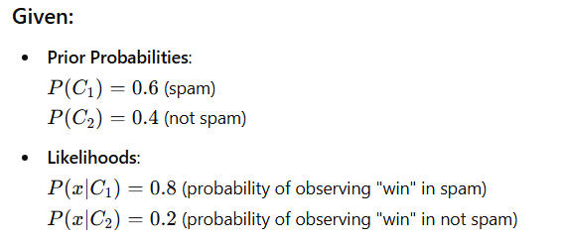

Slide 20
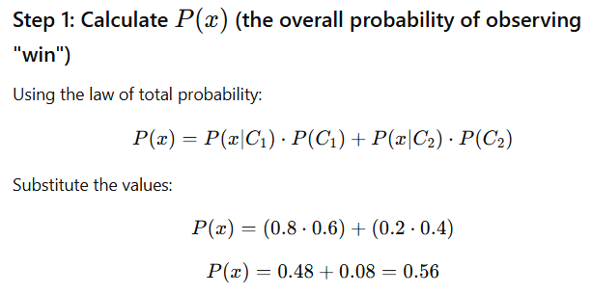
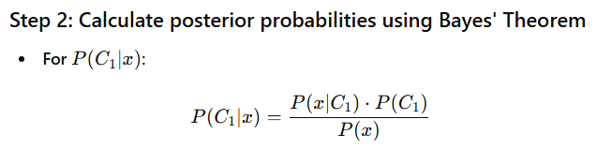

Slide 21
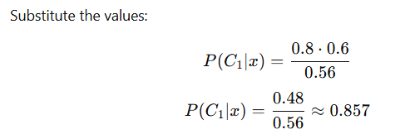
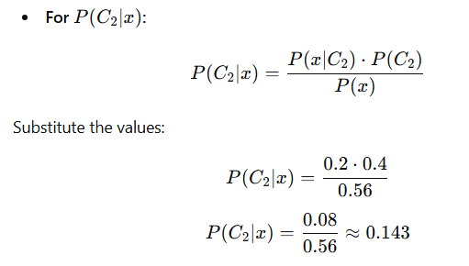
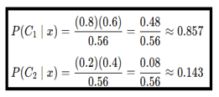

Slide 22
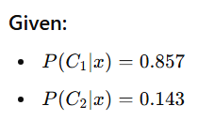
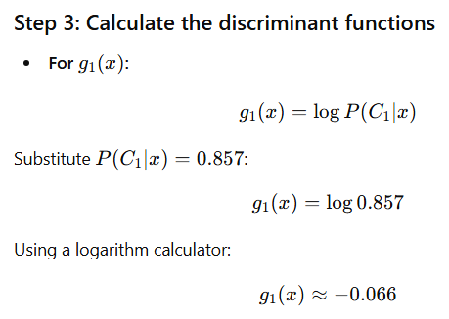

Slide 23
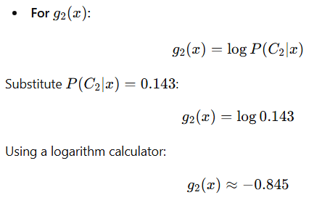

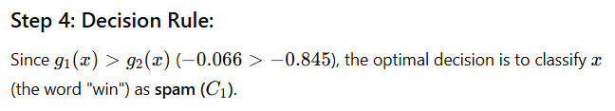

Slide 24

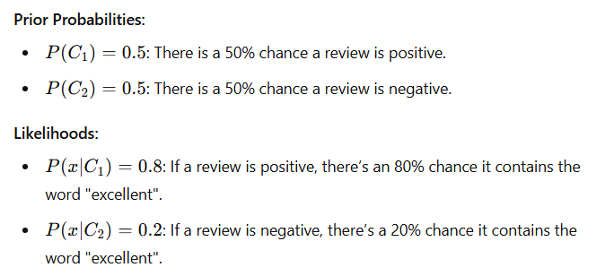
Another Example 3:-

Slide 25
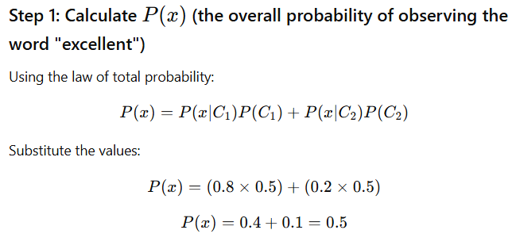
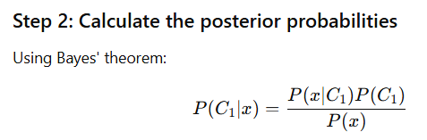

Slide 26
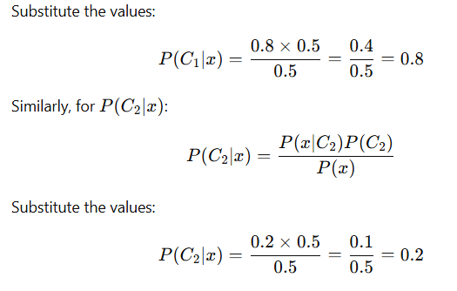

Slide 27
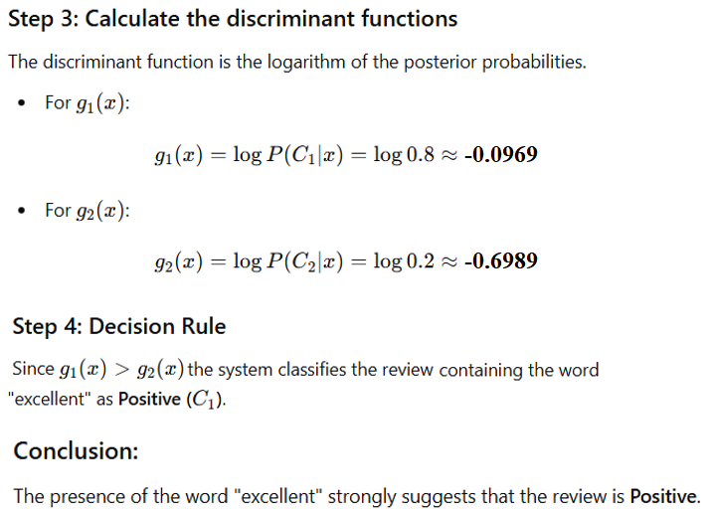

Slide 28
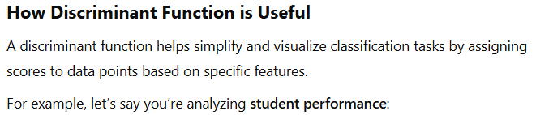
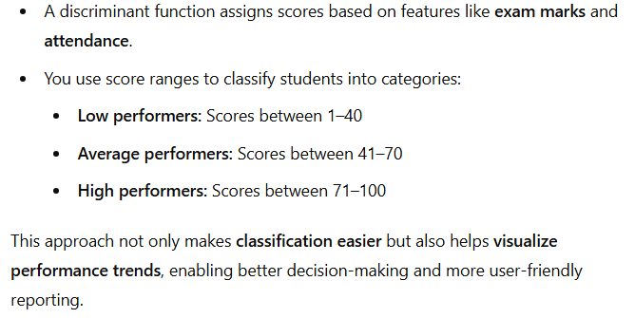

Slide 29
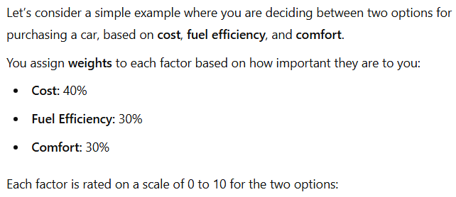
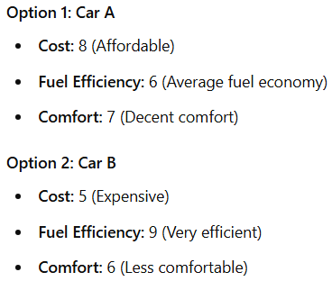
Utility Theory

Slide 30
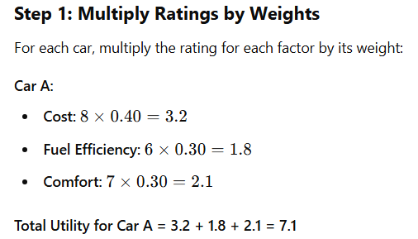
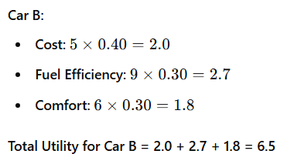

Slide 31
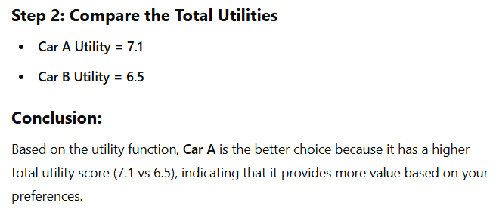
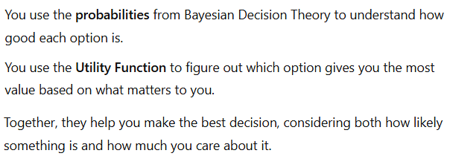

Slide 32
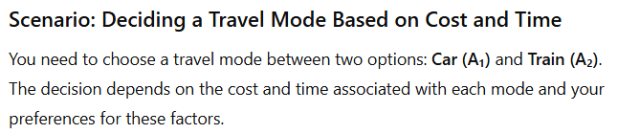

Another Example:-

Slide 33



